Slide 1

Wireshark Network Tracking with Google Maps
by Abhik Das
Reg. No: 22BCE8616

Slide 2

Introduction
In the realm of escalating cyber dangers, the analysis of network traffic stands as a pivotal task. While Wireshark excels in parsing packet-level intricacies, it lacks the crucial elements of geolocation and threat understanding. Our venture transcends these limitations by amalgamating Wireshark data with immersive Google Maps-style visuals and comprehensive threat intelligence.

Slide 3
Visualizing Network Activity with Geo-Mapping
Traditional network analysis tools provide insights into what's happening on the network, but lack the visual context of where those events are occurring. Analysts often have to manually cross-reference IP addresses with external reputation and location data to piece together the full picture.
This gap between raw packet data and geographic understanding limits the speed and effectiveness of network monitoring and incident response. Our tool bridges this divide by integrating network traffic data with interactive Google Maps visualizations, giving analysts a more intuitive and contextual view of network activity and security events.

Slide 4
Existing Solutions
1
Wireshark
Provides packet-level inspection, but lacks visual maps
2
Splunk, Kibana
Powerful tools, but complex and expensive
3
AbuseIPDB, VirusTotal
Offer reputation checks, but not integrated
4
Lack of combined, beginner-friendly solutions

Slide 5
Proposed Solution
Python-powered GUI: Imports Wireshark CSV exports for analysis.
IP identification: Extracts source and destination IP addresses.
Geo and reputation data: Retrieves location and threat intelligence.
Interactive map: Visualizes IPs on a dynamic Google Maps interface.
Filtering and analytics: Filter by country and access traffic insights.

Slide 6





System Architecture Diagram
CSV Input
The app imports network data from Wireshark CSV exports.
IP Extraction
Source and destination IPs are extracted for analysis.
Threat Lookup APIs
AbuseIPDB and VirusTotal provide reputation intelligence.
Geolocation APIs
IPs are geolocated to associate network events with places.
Mapping & Analytics
Folium visualizes IPs on interactive maps with analytics insights.

Slide 7
Tools and Technologies Used
Python & Tkinter: Core language and GUI framework for application.
Pandas & Matplotlib: Data processing and visualization libraries.
Folium: Interactive map creation with Google Maps style.
Wireshark: Network data source via CSV export.
AbuseIPDB & VirusTotal APIs: Threat intelligence and reputation lookup.
IP Geolocation APIs: Location data to map IP addresses visually.

Slide 8
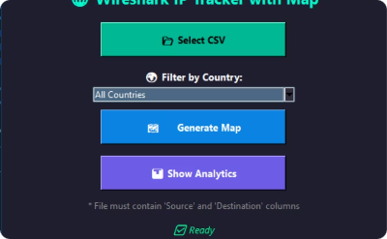
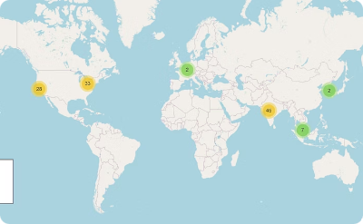
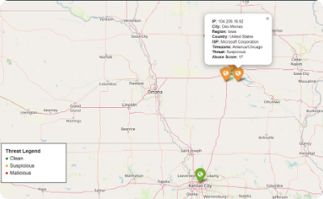
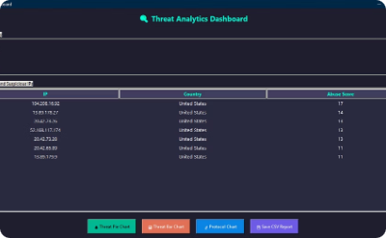
Key Features of Our Network Tracking Tool
CSV File Loader
Geolocation Mapping
Threat Scoring
Country Filtering
Easy import of Wireshark CSV exports through a user-friendly GUI.
Visualize IP addresses on interactive maps for clear geographic context.
Colored markers show reputation scores for quick threat assessment.
Filter network data by country to focus on relevant traffic.

Slide 9
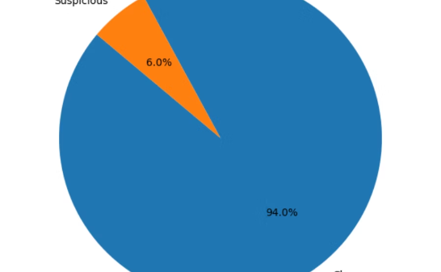
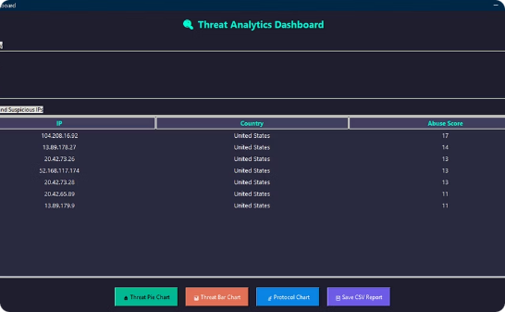
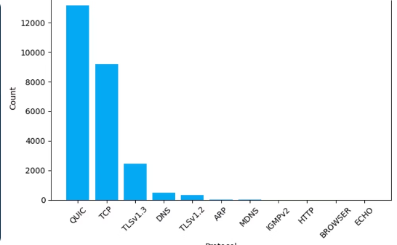
Pie and Bar Chart Analytics
Threat Distribution
Threat Analysis
Protocol Traffic
Visualizes network traffic threat across different countries.
Displays abuse scores to identify high-risk IPs quickly.
Bar plot visualizing the distribution of protocol traffic.

Slide 10
Results and Findings
Malicious IP Identification
Visual Threat Mapping
Detected suspicious IPs linked to specific countries rapidly.
Maps simplified complex traffic analysis with clear visuals.
Protocol and Frequency Trends
Geography and Behavior Correlation
Analyzed protocol distribution and IP activity patterns effectively.
Connected network behavior insights with geographic data points.

Slide 11




Applications of Our Network Tracking Tool
Cybersecurity Education & Training
Internal Network Auditing
Threat Intelligence & Research
Incident Response Support & Network Forensics
Helps students visualize network traffic and understand cyber threats.
Tracks suspicious inbound and outbound connections in organizations.
Correlates malicious IPs with locations for threat hunting and patterns.
Identifies attack origins quickly, aiding prioritization and investigation.

Slide 12
Challenges Faced and Fixes
API Rate Limits: Added delays between requests to avoid being blocked.
Missing Data: Skipped empty geolocation entries to maintain accuracy.
Slow Performance: Optimized memory use and implemented loading indicators.

Slide 13
Future Enhancements
Real-time Packet Capture: Auto-refresh maps displaying live network activity.
Alert System: Instant notifications for high-threat IP detections.
Report Export: Generate detailed PDF and HTML threat reports.
Machine Learning: Predict and flag IP threats using advanced algorithms.

Slide 14
Conclusion
This tool transforms raw network data into clear visual intelligence.
It's user-friendly and integrates trusted real-world threat data.
Ideal for students and analysts beginning their cybersecurity journey.
User-Friendly Design
Integrated Threat Data
Educational and Practical
Intuitive interface simplifies complex network data analysis.
Leverages multiple APIs for accurate reputation and geolocation.
Supports learning and real-world threat detection for beginners.

Slide 15

Thank You
We appreciate your time and interest in our network tracking solution.
Feel free to ask questions or request further details about the project.

